Slide 1
2022 CLUB ORIENTATION

Slide 2
Agenda
Club Vision & Governance
Board Member Introduction
Technical Structure
Code of Conduct
Communication & Complaint Process
Wet Weather Procedure
Uniform Standards
Training Requirements
Match Day Requirements

Slide 3
Club Vision
To be a true representative football club for Toowoomba & South West Queensland.
Our focus is provide a quality football education that provides opportunities for players to maximise their potential through continuous improvement.

Slide 4
Club Governance
SWQT affiliates directly to Football Queensland
Operates as a High Performance Club
SWQT isn’t linked to FQ Darling Downs but is actively supported by them
Operates as a recognised Player Pathway for elite players throughout the South West Queensland region
Company Limited by Guarantee

Slide 5
SWQ Thunder Board & Portfolios
Luke Stenhouse Chairperson
Michael Clarkson Vice Chairman, Registrar, Membership, Grants & Governance
Laurie Passante Club Secretary & Media
Emma Bowdler Treasurer
Stef Hlaca Football Performance
Jason Hall Football Operations
David Scutt Football Development & Engagement
Genevieve Duncan Fundraising, Events & Uniforms
Janelle Sothmann Football Operations Manager

Slide 6
Players Code of Conduct
Play for the “love of the game” and not just to please parents and coaches
Football is a team game – work equally hard for yourself and your team. Your teams performance will benefit, so will you
Play by the rules
Never argue with an official. If you disagree, have your coach approach the official during a break or after the game
Be a good sport. Be able to win and lose well
Treat all players as you would like to be treated. Do not interfere with, bully or take unfair advantage of another player

Slide 7
Players Code of Conduct
You will be expected to display the highest level of discipline and respect before, during and after games
You will be expected to show respect to fellow players, coaching staff, referees, spectators, Club members, and other opposition and visiting team members
This also extends to all spectators at all home and away games including training
Remember, you are representing your club, your region, community football, your family and most importantly, YOURSELF!

Slide 8
Parents Code of Conduct
Remember that young people play football for their enjoyment, not yours. If a player is reluctant, encourage but don’t force them
Focus on the players efforts and performance rather than winning or losing
Assist in setting realistic personal goals related to his/her ability
Encourage players to always play according to the laws of the game
Never ridicule or yell at a young player for making a mistake or losing a game
Remember all players learn best from example. Applaud good play by both teams

Slide 9
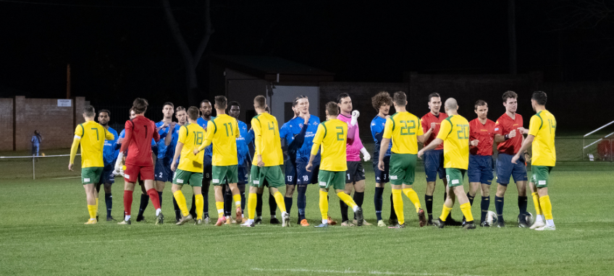
Sportsmanship ALWAYS!

Slide 10
Communication Process
Team Communication
Majority of communication will be through WhatsApp / Facebook group for quick, effective communication
In majority of cases, Manager will be communicating with the team
Club Communication
Majority of communication will be via email and in addition, Social Media

Slide 11
Complaint Process
On occasion, parents may have concerns about player welfare, time on field, illness, injury etc.
Parents are to broach any issues with the Manager first:
Managers will bring complaint to the attention of the Coaching staff & TD
With Coaching staff and TD, decide on best course of action to address complaint
Manager to respond to parent and player in professional, caring manner
If Parent / Player wishes to take complaint further, direct them to the TD
Inform Coaching staff and TD of the escalation of the complaint

Slide 12
Injury Management
The Fit Lab are our Strength & Conditioning Partners along with our preferred Physiotherapist provider
Benefits:
Discounted Physiotherapy services
Discounted Gym membership
Discounted Athlete Academy Membership
Ensure you tell them you are with SWQ Thunder!

Slide 13
Injury Management
Serious injuries will be reported to the club by the Team Manager
Serious injuries include (but aren’t limited to):
Head injuries
Broken bones
Bad sprains
Muscle strains / tears
Any injury requiring ambulance / hospitalisation
Serious cuts, lacerations
Serious Injuries require medical clearance (Physiotherapist, Doctor )
prior to returning to training

Slide 14
Wet Weather
If grounds are closed, your Coaches/Managers are notified
If it storms or rain throughout the day, we make a decision as early as possible. Coaches/Managers are notified immediately. This allows them enough time to notify country players first & then other players
A wet weather notice will be posted on the SWQ Thunder Facebook Page
For away matches, communication is made as soon as we receive confirmation from the host club. This can mean players are already travelling

Slide 15
Training Commitments
Arrive to training a MINIMUM of 15 minutes before start time
If you cannot attend training, you must let your Manager & Coach know at least 3 hours prior to training start time
Acceptable training absences:
Sickness
Injury
School Commitments (within reason)

Slide 16
Training Commitments
As a Semi-Professional club, we require our players to commit to training three times per week.
Men, U23’s & U18’s
Women, U23’s & U16’s
U16 – U9 Boys
Highfields Sports Park
Monday, Wednesday, Thursday
Kratzke Road Fields
Monday, Wednesday, Thursday
Captain Cook Fields
Monday, Wednesday, Friday
Boys will move to Middle Ridge Park – Approximately Term 2
(Date TBA)

Slide 17
Match Day Commitments
Players are expected to play all matches throughout the season
Acceptable reasons for absence:
Sickness
Injury
Additional reasons should be discussed with the Coach & Manager
Injured players are expected to attend training and matches to support their team

Slide 18
Match Day Commitments
SAP
Required to arrive 45 minutes prior to the match (local) & 60 minutes (Brisbane, Gold / Sunshine Coast)
Remainder of the Club
Required to arrive at each match day at least 1 hour & 15 minutes prior to the commencement of the match
Match Day Run Through
Change into match uniform
Warm Up
Pre-match discussion with Coach

Slide 19
Uniform Standards
Our official Uniform supplier is Kappa & is the only uniform that we wear to training, match days & on field.
The ‘Omini’ Logo
Features the silhouette of a man and woman leaning against each other
This represents the equality of men and women and their mutual support of each other
Kappa was one of the first brands to do gender specific sports apparel

Slide 20
Uniform Standards
SWQ Thunder is the representative club of the region.
A high level of professionalism and presentation is expected from all players, coaches and managers.
We supply a uniform to ensure we maintain these standards.
Please ensure at all times, you respect the SWQ Thunder brand & the entire club.
Remember, you are representing a REGION

Slide 21
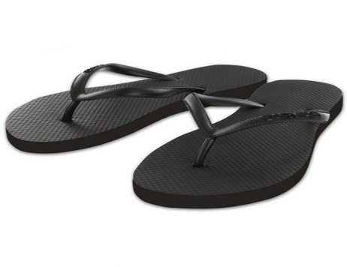
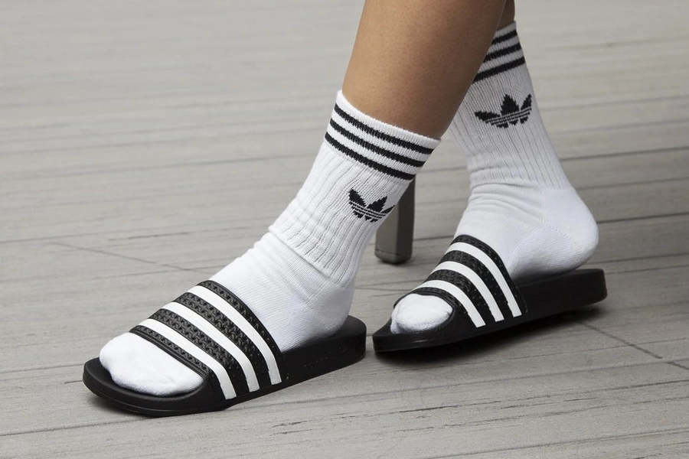
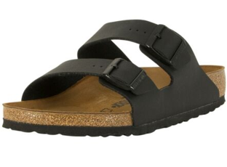
Uniform Standards
What we DON’T Wear:
Slides / thongs / sandals / bare feet to or from training or matches
Non Thunder clothing items including:
Caps
Jumpers
Socks

Slide 22
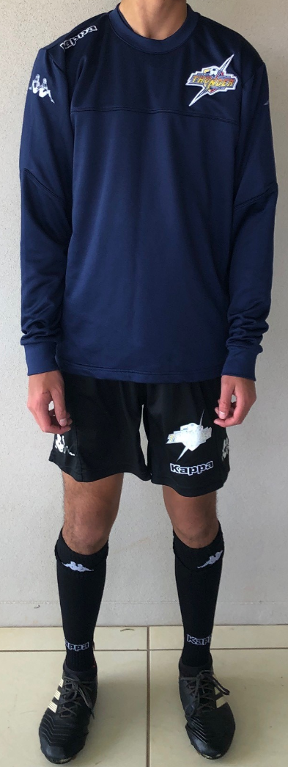
Uniform Standards
Training Uniform Standards
To wear:
Training Jersey
Black Training shorts (no pockets)
Black training socks
Boots
Shin Guards
Pullover (if required for warmth)
Spray Jacket (if required for warmth / wet weather)
Track pants (if required for warmth)

Slide 23
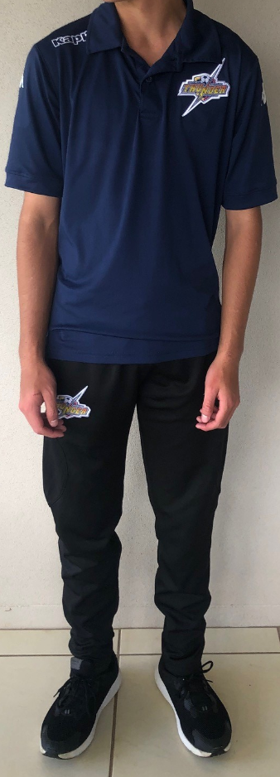
Uniform Standards
To & From Match Uniform Standards
To wear:
Polo Shirt
Black Travel Shorts (with pockets)
Black travel socks
Shoes / Joggers
Pullover (if required for warmth)
Spray Jacket (if required for warmth / wet weather)
Track pants (if required for warmth)
Thunder Cap

Slide 24
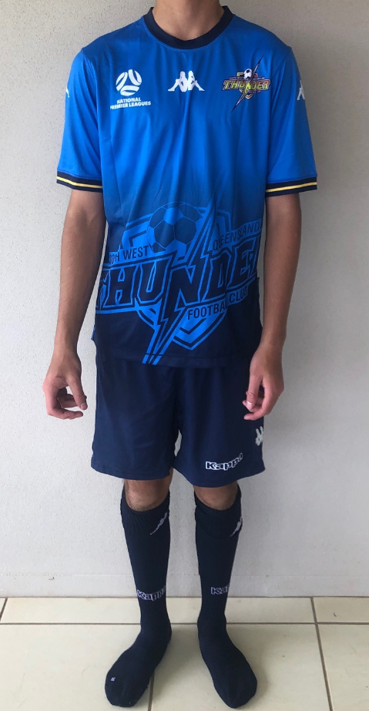
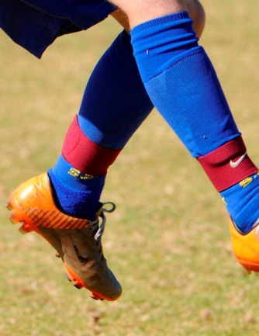
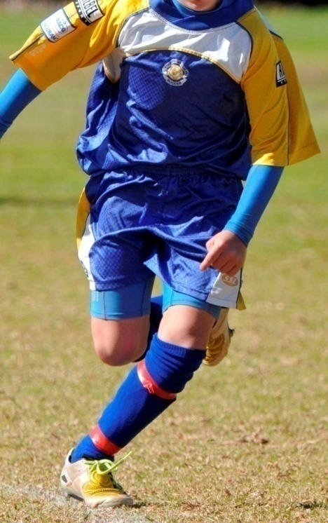
Uniform Standards
Match Wear
To wear:
SWQ Thunder Jersey
SWQ Thunder training shirt (to warm up in)
SWQ Thunder Shorts
SWQ Thunder Navy Socks (Home)
‘Skin’ Undergarment (Pants & Tops)
Must be the same colour as the Navy Blue shorts
Tape / Shin Guards straps must be the same colour as the Navy socks
ALWAYS BRING YOUR TRAINING JERSEY TO WARM UP IN

